Slide 2
Expressões
Prof° Gustavo Garcia

Slide 3
Expressões comuns
To make a backup – fazer um backup
To do the laundry – lavar roupas
To do the dishes – lavar louças
Sometimes – as vezes
Conference room – sala de reuniões
Full time – período integral
Part time – meio período
This time – Dessa vez
Sold out – esgotado, vendido
To be quiet – estar quieto

Slide 4
Expressões de tempo
All day long – o dia todo
All night long – a noite toda
Once again – mais uma vez
To work out – exercitar-se
On vacation – de férias
Right away – agora mesmo
To go to bed – ir dormir
Tomorrow morning – Amanha de manhã

Slide 5
Numeração

Slide 6
Números
0 Zero
1 One
2 Two
3 Three
4 four
5 five
6 six
7 seven
8 eight
9 nine
10 ten
11 eleven
12 Twelve
13 Thirteen
14 Fourteen
15 Fifteen
16 sixteen
17 seventeen
18 eighteen
19 nineteen
20 twenty
21twenty one
22 twenty two
30 Thirty
40 forty
50 fifty
60 sixty
70 seventy
80 eighty
90 ninety
100 one hundred
200 two hundred
1000 one thousand
2000 two thousand
10000 tem thousand

Slide 7
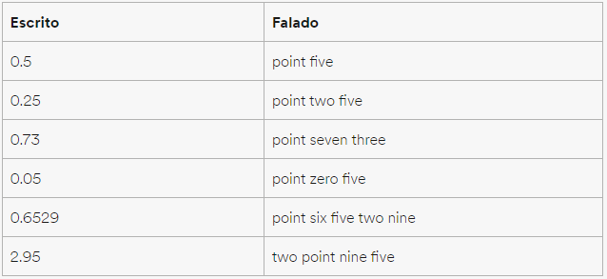
Decimais

Slide 8
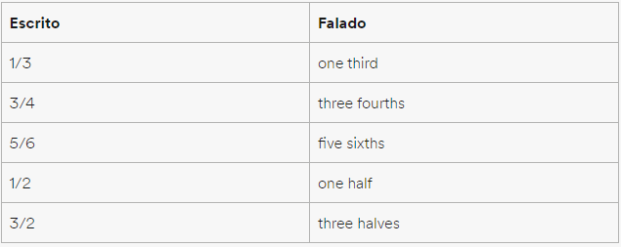
Frações

Slide 9
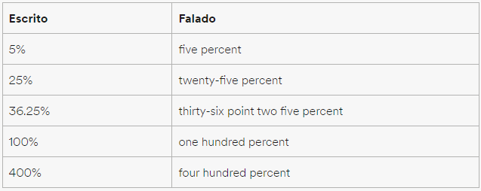
Porcentagem

Slide 10
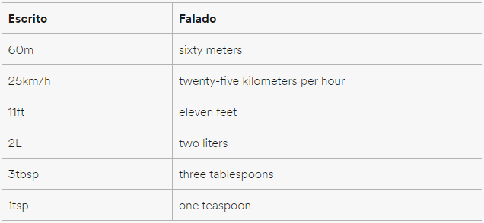
Unidades de medida

Slide 11
Números - Anos
1956 – nineteen fifty six
1990 – nineteen ninety
1821 – eighteen twenty-one
2000 – Two Thousand
2010 – two Thousand ten
1901 – nineteen oh one
866 - eight hundred sixty-six ou eight sixty-six

Slide 12
Números ordinais
1st- First
2nd- Second
3rd- third
4th- fourth
5th-fifth
6th- sixth
7th- seventh
8th- eighth
9th- ninth
10th-tenth
11th-eleventh
12th- twelfth
13th- thirteenth
14th-fourteenth
15th- fifteenth
16th- sixteenth
17th- seventeenth
18th- eighteenth
19th- nineteenth
20th- twentieth
21st- twenty-first
22nd-twenty-second
30th- thirtieth
40th- fortieth
50th- fiftieth
60th-sixtieth
70th- seventieth
80th- eightieth
90th- ninetieth
100th- one hundredth

Slide 13
Atividade 1
Responda as questões abaixo com os números por extenso (duplas):
1 - What’s your zip code? (Qual o seu CEP?)
2 - What time is it?
3 - When is your birthday?
4 - When were you born?
5 - How long ago did you buy your sneakers?
6 – How much your phone?
7 – How many days do you go to school?
8 – What is your favorite hour?
9 – How much a GT600 mustang?
10 - When was your father born?

Slide 14
Atividade 2
Descreva por extenso os anos em inglês:
1550
1600
1758
1804
1945
1985
2001
2007
1545
1600
700
654
905
111
101
1098
2150
2200

Slide 15
Referencias
Materiais extraídos de:
https://www.todamateria.com.br/tempos-verbais-no-ingles/
https://www.ef.com.br/guia-de-ingles/gramatica-inglesa/numeros-em-ingles/

Slide 16
Notes:
Listar itens e Criar dois cenários

